Slide 1
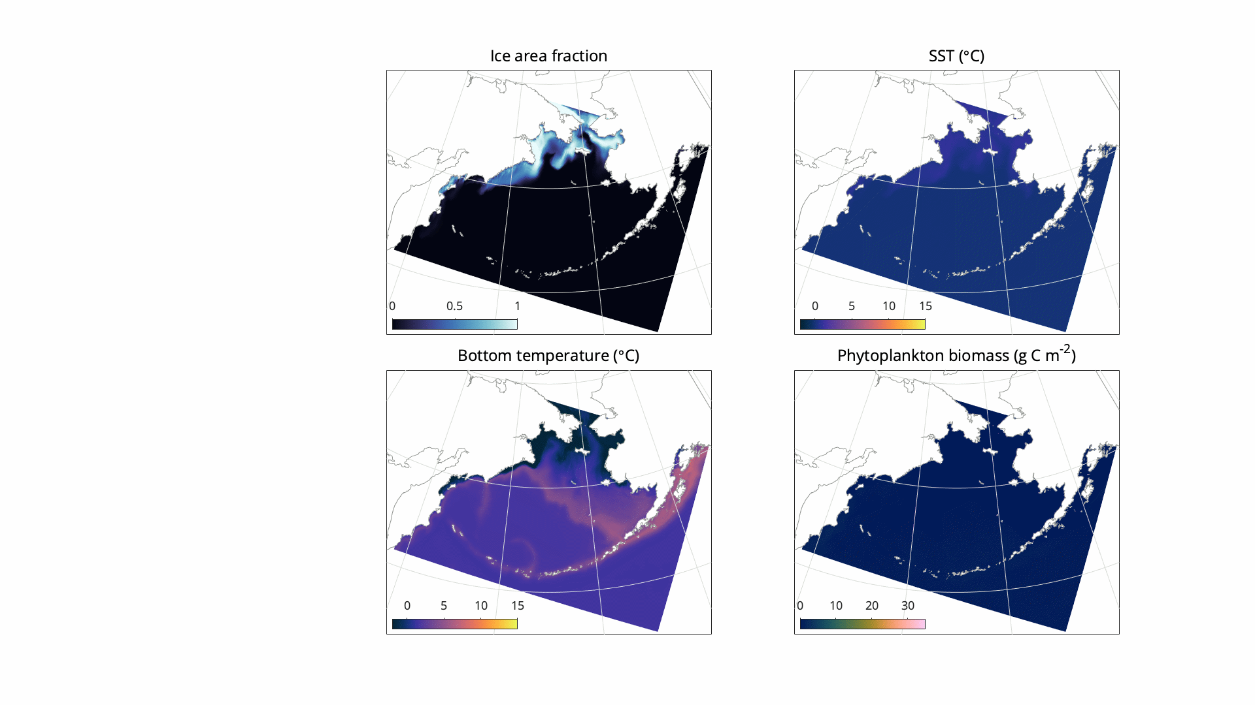
How well do the Bering10K hindcast simulations perform?
Bering Seasons Workshop
kelly.kearney@noaa.gov
Notes:
Kearney et al, 2020 provides full documentation of the most recent version of the Bering10K model. It also quantifies the model’s ability to reproduce key physical features of biological importance as well as its skill in capturing the seasonal and interannual variations in primary and secondary productivity over the past several decades. This validation focuses on the eastern Bering Sea shelf region. The highlights…

Slide 2
Temperature profiles
(a)
M2
Observations = mooring
(M2 mooring)
Depth-integrated temperatures, spring/summer
Interannual variability
Depth-integrated temperatures, winter
(b)
M4
(c)
M2
(d)
M4
Bering Seasons Workshop
kelly.kearney@noaa.gov
Notes:
First, sea ice. Sea ice plays a key role in modulating many biophysical properties, such as surface and bottom temperature, stratification, and light levels. When compared to satellite measurements of ice cover, Bering10K does very well replicating the interannual variability in sea ice extent and date of ice advance. However, sea ice retreat tends to be biased late by about 2 weeks. This is an improvement over an earlier version of Bering10K, where retreat was ~1 month late (see Hermann et al., 2016), but still has room for more improvement.

Slide 3
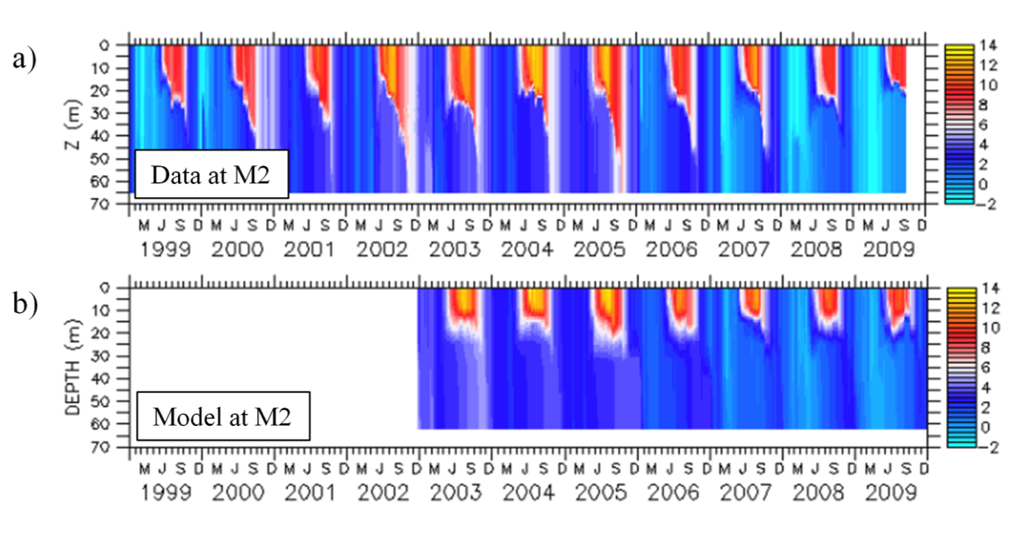
Mixed layer depth
Observations = mooring
(M2 mooring)
Shallow bias, especially in fall
Bering Seasons Workshop
kelly.kearney@noaa.gov
Notes:
First, sea ice. Sea ice plays a key role in modulating many biophysical properties, such as surface and bottom temperature, stratification, and light levels. When compared to satellite measurements of ice cover, Bering10K does very well replicating the interannual variability in sea ice extent and date of ice advance. However, sea ice retreat tends to be biased late by about 2 weeks. This is an improvement over an earlier version of Bering10K, where retreat was ~1 month late (see Hermann et al., 2016), but still has room for more improvement.

Slide 4
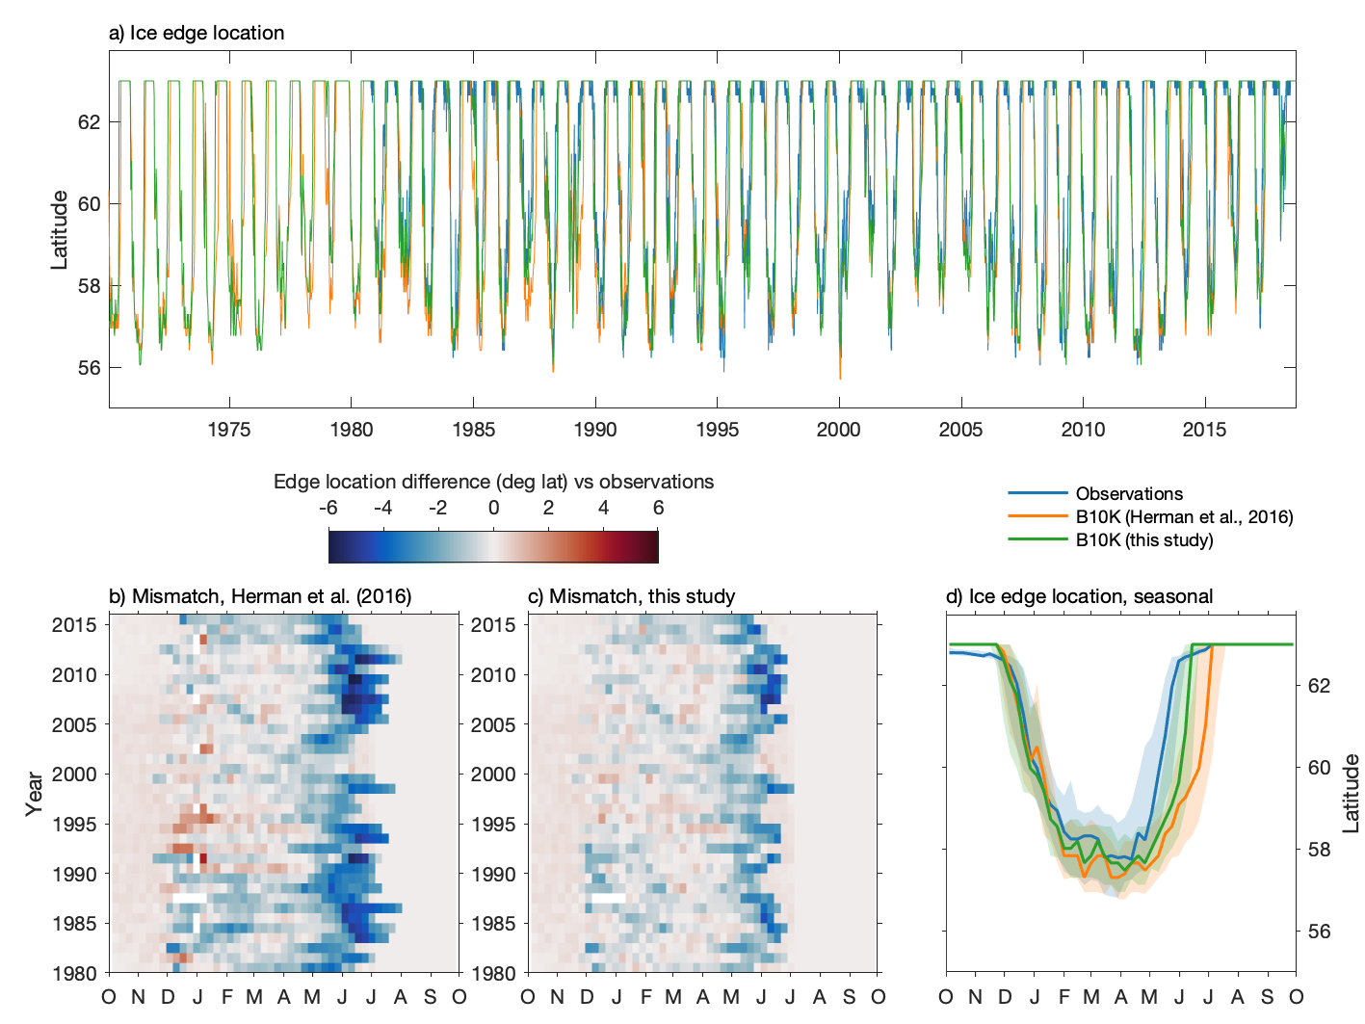
Sea ice timing and extent
Observations = satellite (Nimbus-7 SMMR and DMSP SSM/I- SSMIS passive microwave data)
Sea ice extent
Date of ice advance
Date of ice retreat
Bering Seasons Workshop
kelly.kearney@noaa.gov
Notes:
First, sea ice. Sea ice plays a key role in modulating many biophysical properties, such as surface and bottom temperature, stratification, and light levels. When compared to satellite measurements of ice cover, Bering10K does very well replicating the interannual variability in sea ice extent and date of ice advance. However, sea ice retreat tends to be biased late by about 2 weeks. This is an improvement over an earlier version of Bering10K, where retreat was ~1 month late (see Hermann et al., 2016), but still has room for more improvement.

Slide 5
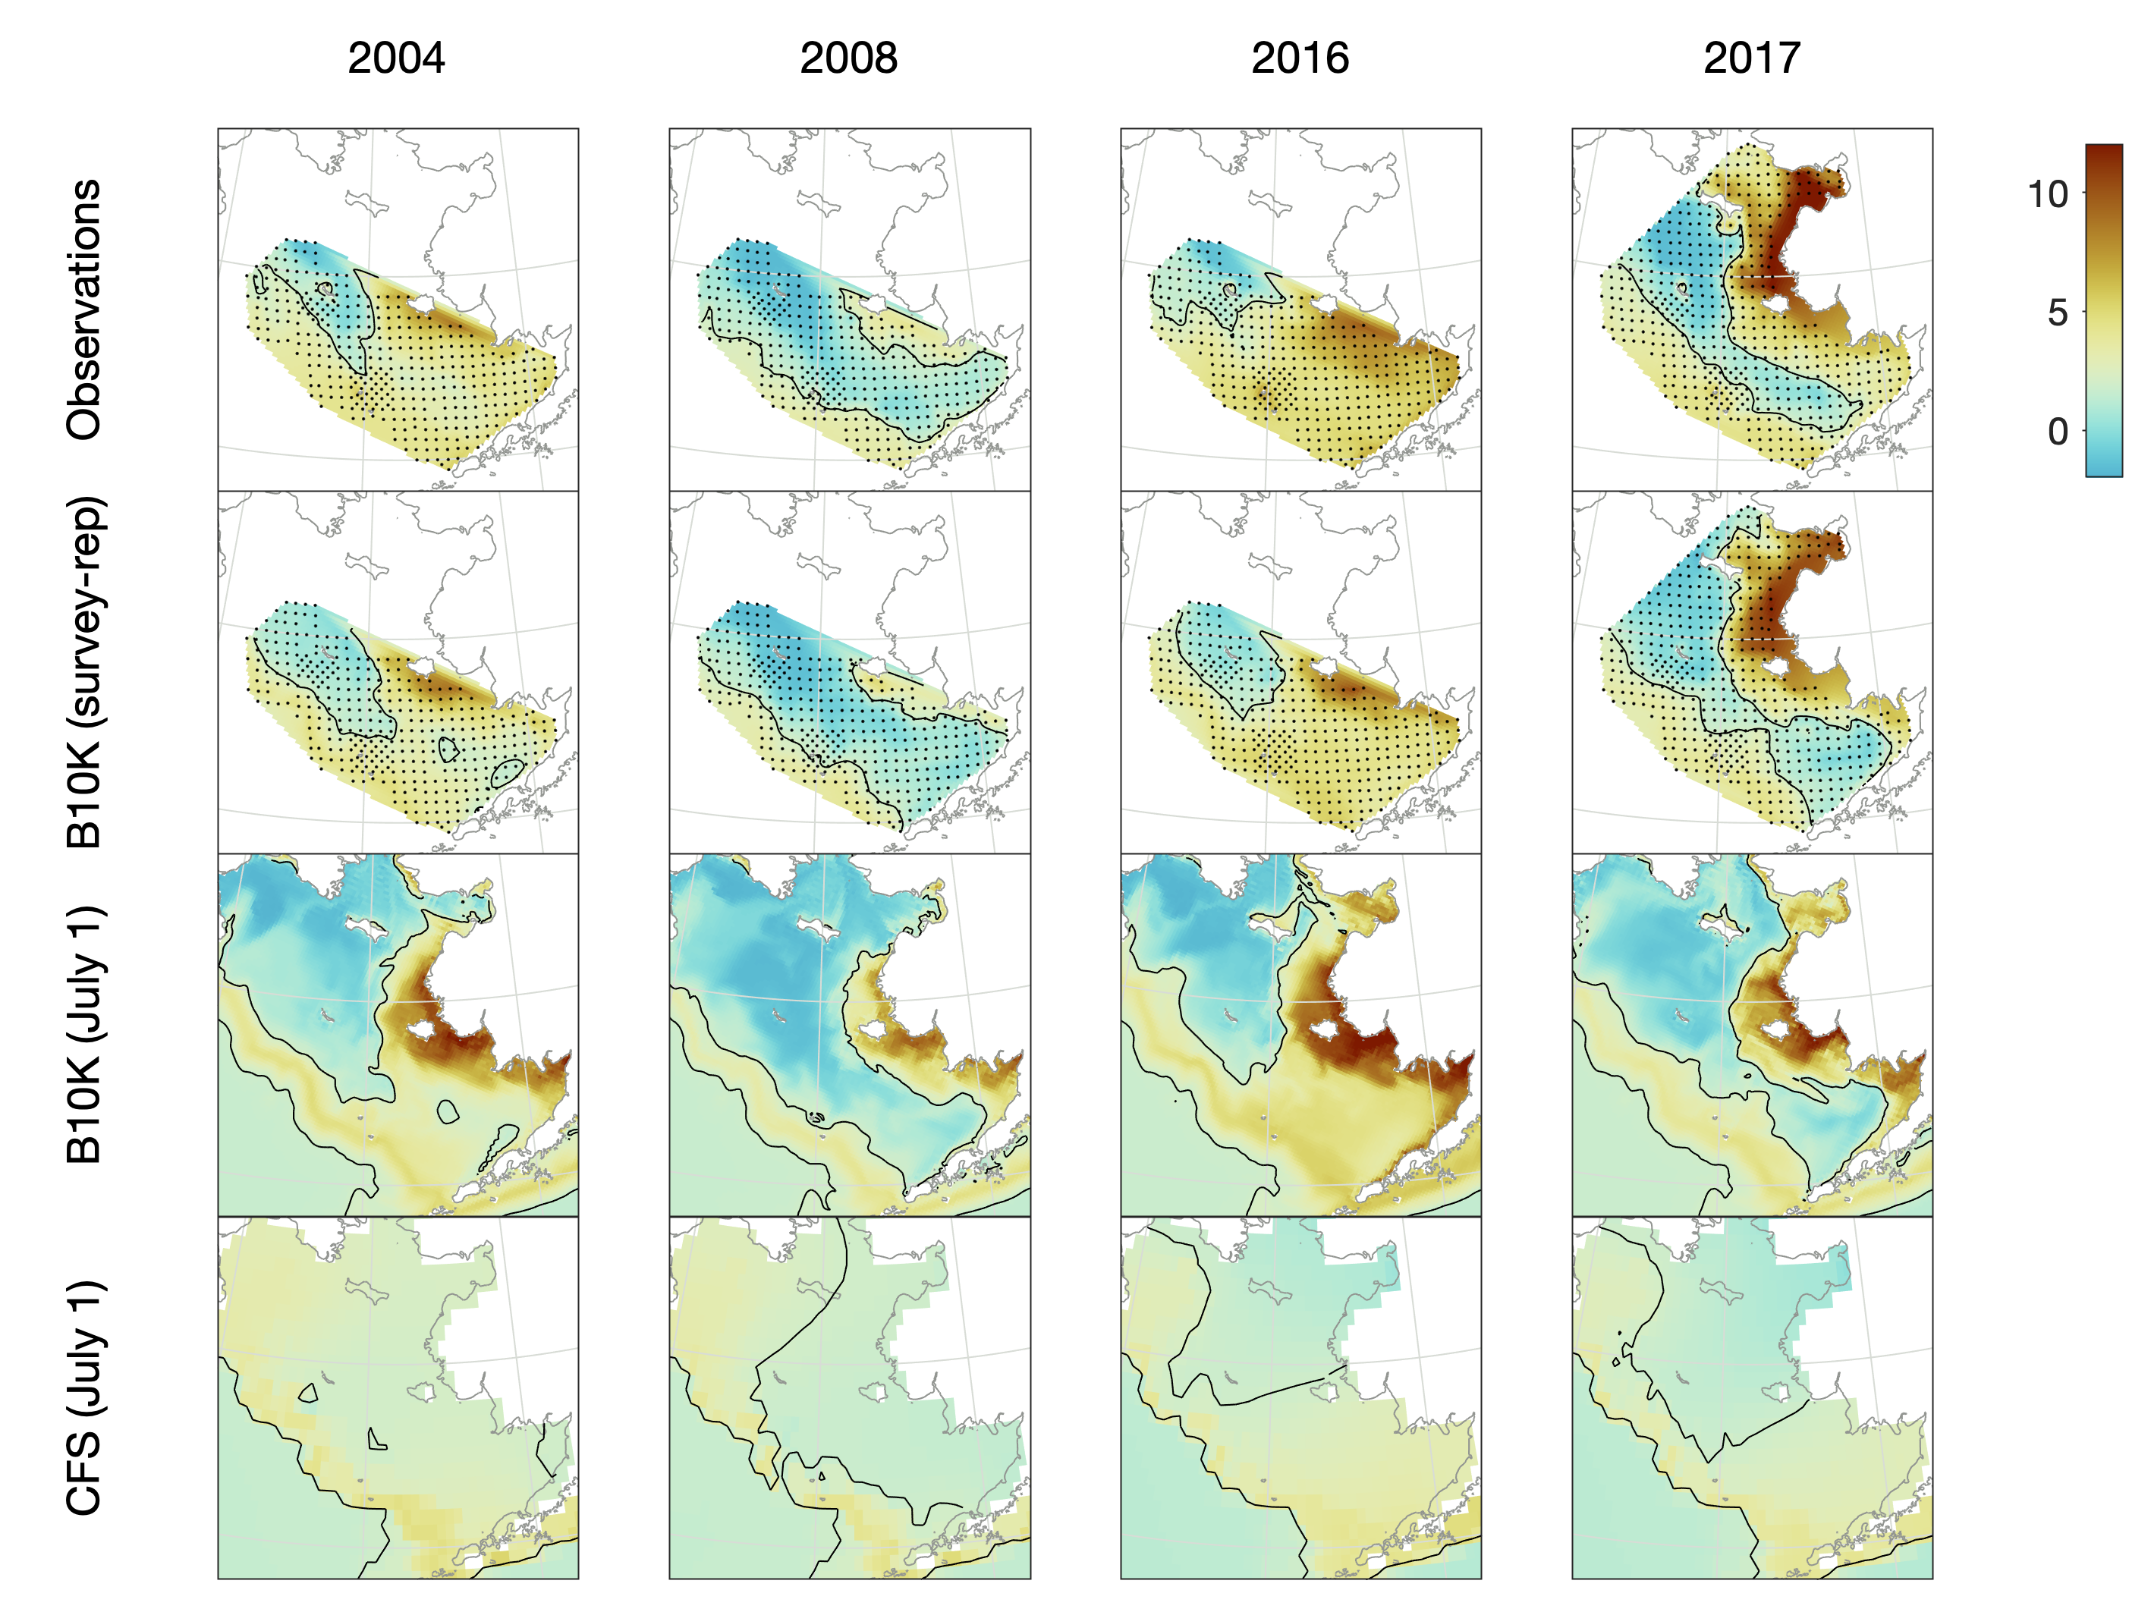
The Cold Pool
Observations = AFSC groundfish survey
 | Correlation | Bias | Model Efficiency
Bottom temp | 0.905 | -0.104 | 0.800
0ºC index | 0.940 | 0.009 | 0.778
2ºC index | 0.884 | 0.026 | 0.714
Bering Seasons Workshop
kelly.kearney@noaa.gov
Notes:
The cold pool is a mass of cold, dense water formed during sea ice formation; its extent across the eastern shelf in summer is a commonly-used indicator in stock assessments and other biological models. When compared to values measured on the AFSC annual groundfish survey, Bering10K does well capturing the variations in this water mass; this example show observations and model bottom temperatures in a typical warm year (2004), a typical cold year (2008), an atypical (blob-influenced) year (2016), and a northern survey year (2017). The final row shows how the non-downscaled CFS model compares to Bering10K with CFS-derived boundary conditions; the coarser-resolution CFS model does resolve waters below ~2 degrees C.

Slide 6
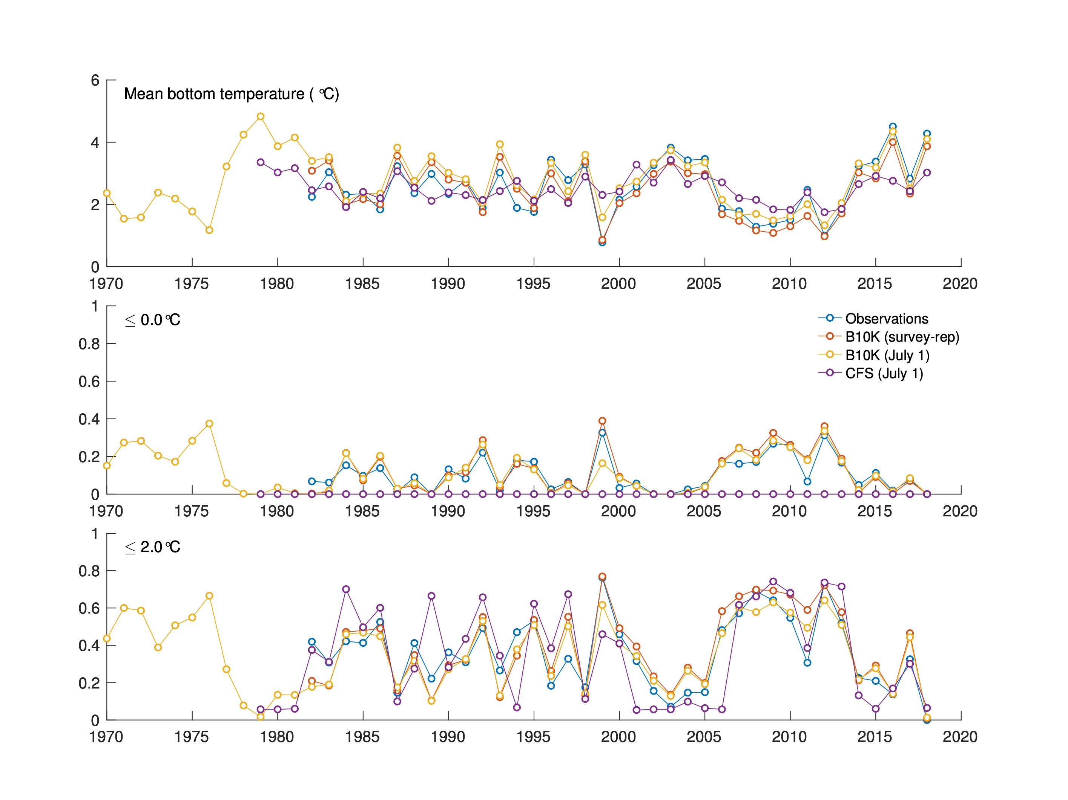
The Cold Pool
Observations = AFSC groundfish survey
 | Correlation | Bias | Model Efficiency
Bottom temp | 0.905 | -0.104 | 0.800
0ºC index | 0.940 | 0.009 | 0.778
2ºC index | 0.884 | 0.026 | 0.714
Bering Seasons Workshop
kelly.kearney@noaa.gov
Notes:
Time series of the cold pool index (fraction of survey polygon with bottom temperature below the indicated threshold) also show very high correlation between Bering10K and observations. Note that non-downscaled CFS underestimates variability in the 2-deg index and completely misses the 0-deg index, while the downscaled Bering10K values capture these variations quite well.

Slide 7
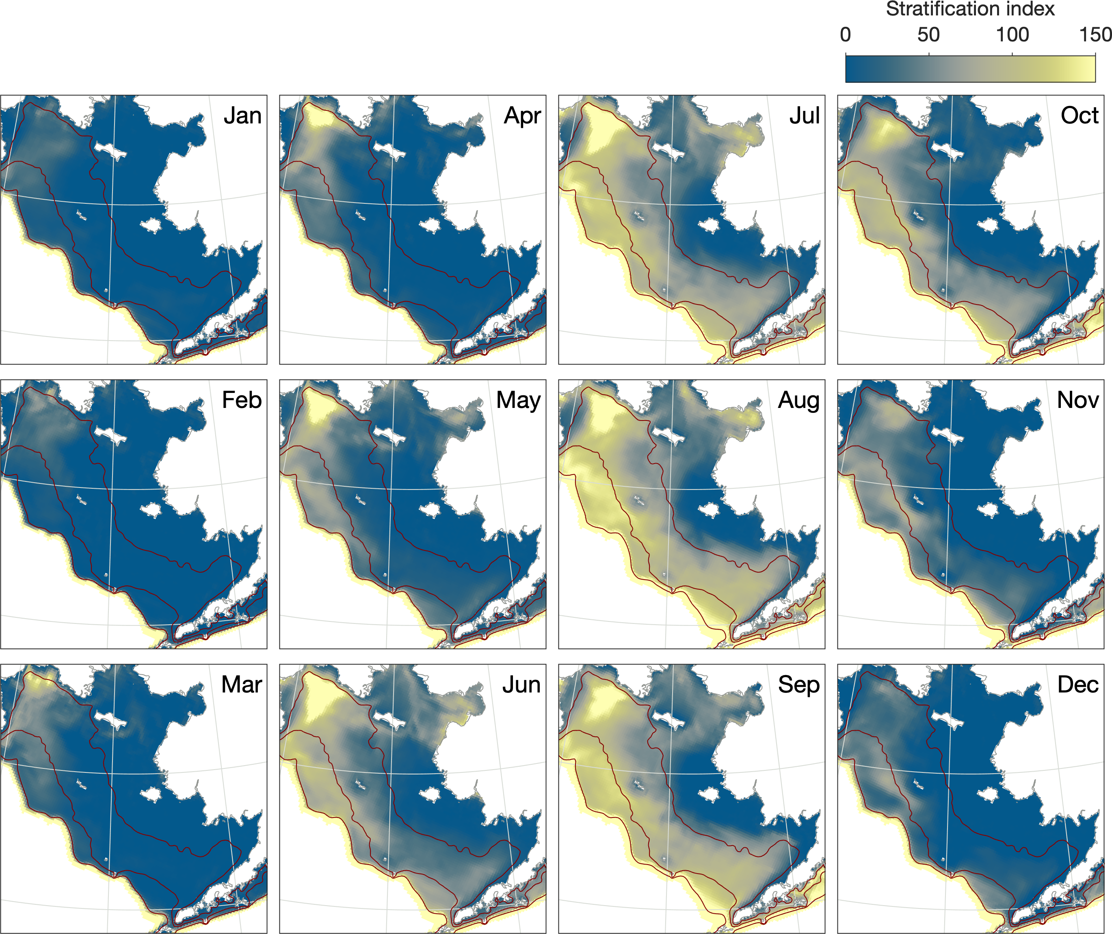
Stratification
Observations = literature, qualitative (Coachman, 1986; Kachel et al., 2002; Stabeno et al., 2012)
Distinct mixing regimes
Inner/middle domain front
Middle/outer domain front
Bering Seasons Workshop
kelly.kearney@noaa.gov
Notes:
The eastern Bering Sea shelf can be divided into 3 regions: an inner domain that is well-mixed year round, a middle domain that is well-mixed in winter and strongly thermally stratified in summer, and an outer domain that experiences more ocean-like stratification. Bering10K captures the distinction between inner and middle well, with distinct patterns of stratification in each. However, the coarse vertical resolution (only 30 layers) prevents much distinction between the middle and outer domains in the model; no clear front between these regions is seen. The outer domain in the model, as defined by isobaths (100-200 m) is also narrower in the model than the real world, a necessary compromise because too-steep topography can cause numerical problems in sigma-coordinate models like ROMS.

Slide 8
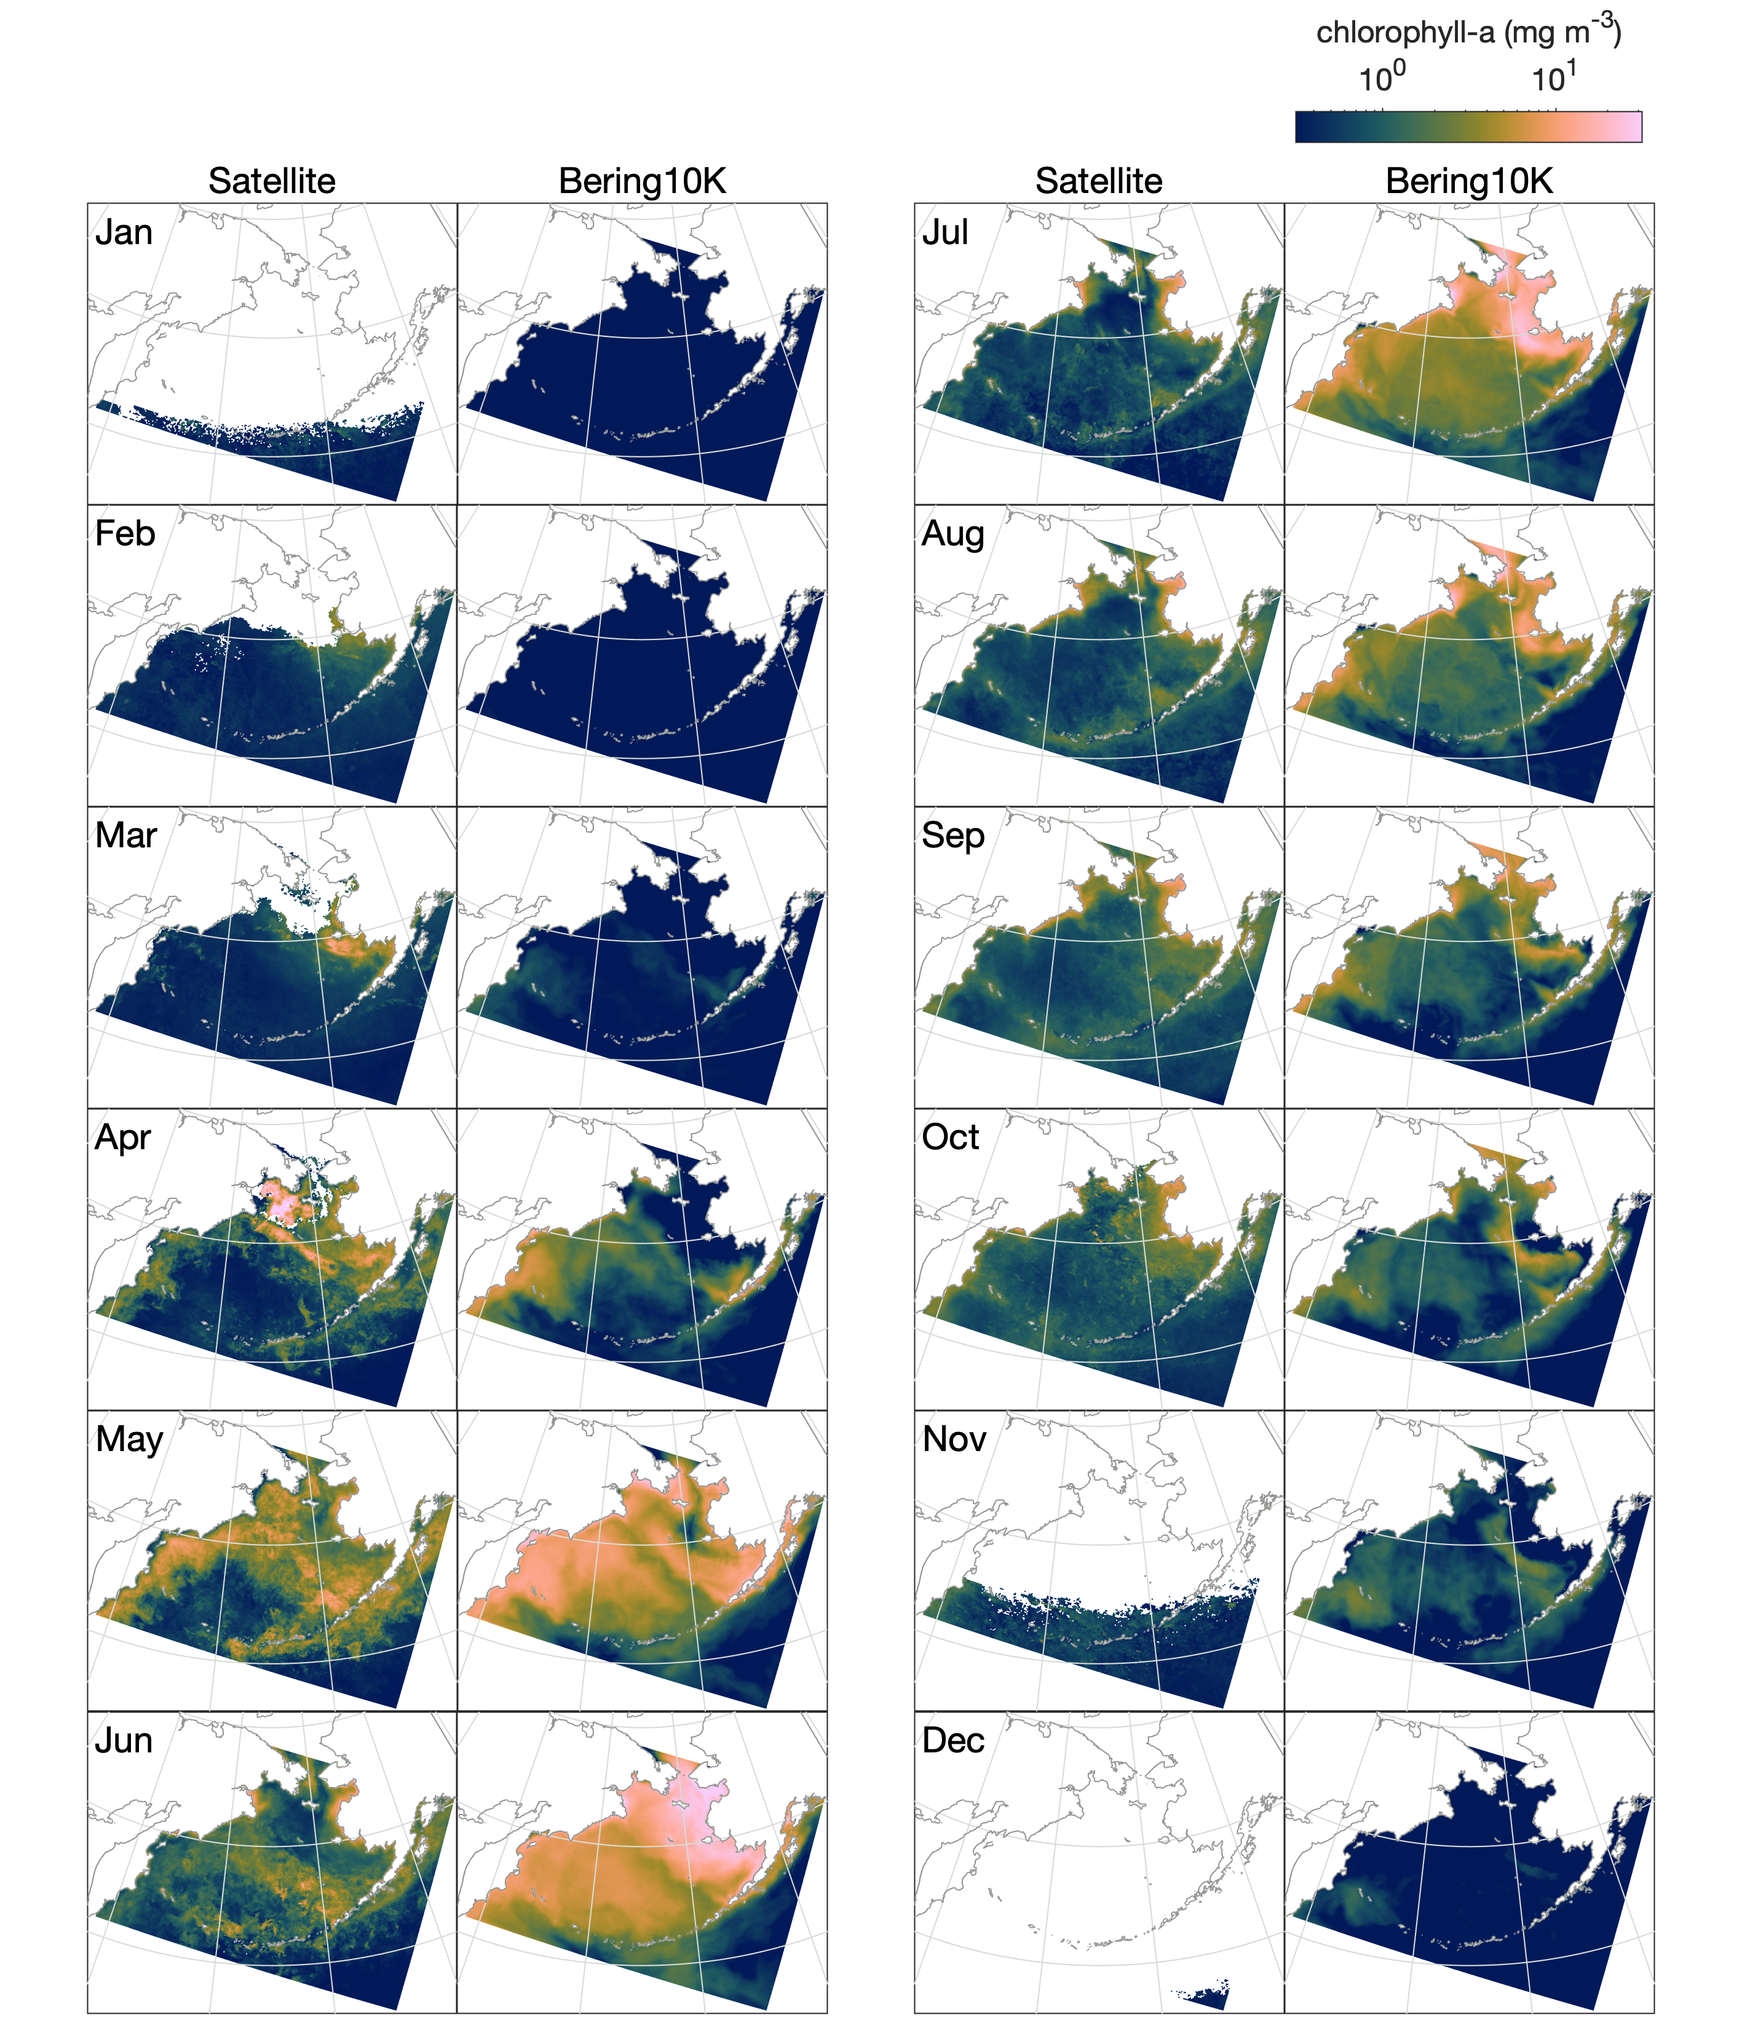
Primary production
Observations = satellite
(MODIS Aqua Ocean Color Index (OCI) algorithm, 4km resolution, mean July 2002–July 2015)
Ice-edge and under-ice blooms
Large spring bloom on shelf
Low summer productivity on shelf
Smaller fall bloom on shelf
Basin is iron-limited
Bloom timing affected by sea ice extent and retreat date
Bering Seasons Workshop
kelly.kearney@noaa.gov
Notes:
While Bering10K is very skillful at capturing physical features of biological importance, it has mixed success with regards to the biological processes themselves. The reasons are multifold:
Ice edge and under-ice blooms: In Bering10K, low light and very cold temperatures severely limit simulated growth, so we do not simulate the early season ice-associated assemblages that are observed in the Bering Sea (despite the inclusion of an ice algae state variable). In general, the dynamics of ice algae and under-ice phytoplankton blooms are still not well understood, and therefore difficult to model. This remains an area of active research.
The mean seasonal cycle of phytoplankton production is captured decently, with a large spring bloom, lower summer production, followed by a small fall bloom.
The off-shelf basin region is an HNLC region, with low production due to low bioavailable iron. Currently, Bering10K uses a very simple model of iron dynamics, and it fails to capture this feature. As a result, modeled production in the basin is too high, and obscures the characteristic Green Belt that should be seen just off-shelf.
Spring bloom timing should be influenced by sea ice retreat, with earlier or later blooms depending on the date of retreat and resulting stratification or lack thereof. However, Bering10K-BESTNPZ fails to simulate early spring dynamics (primarily ice-associated assemblages) and therefore does not show much interannual variability in the timing of its blooms.

Slide 9
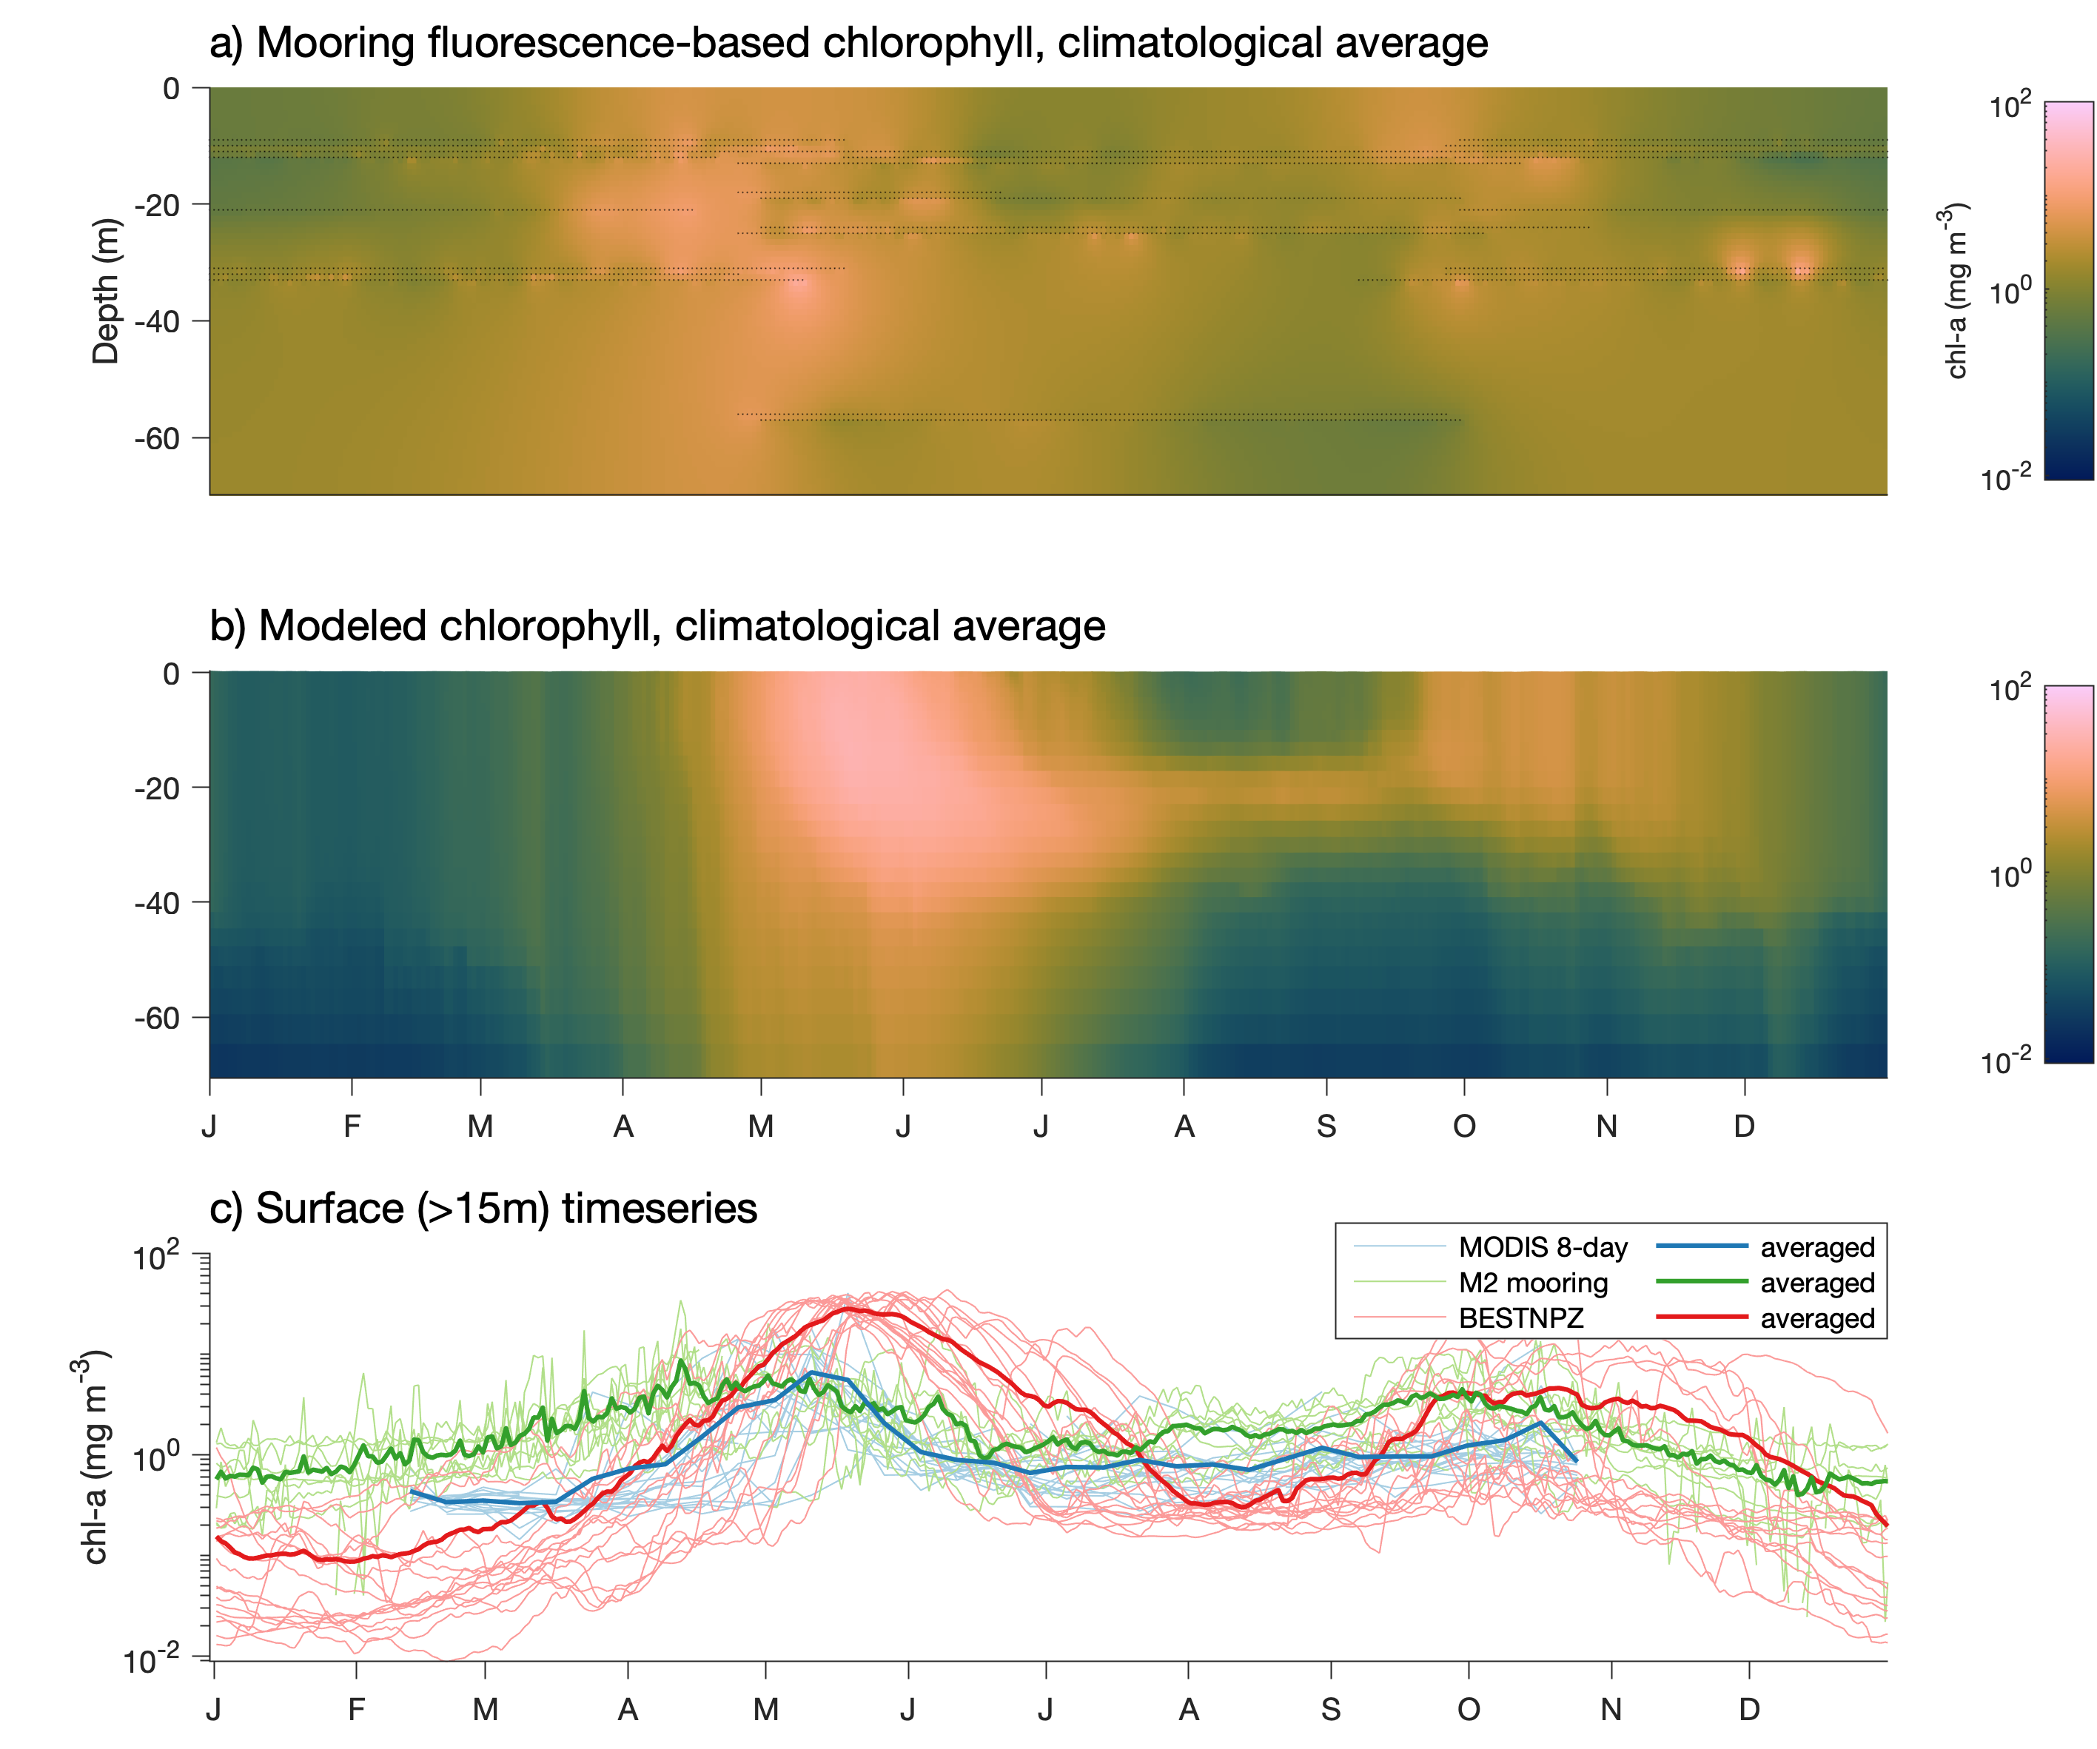
Primary production
Observations = mooring
(M2 mooring fluorescence)
Ice-edge and under-ice blooms
Large spring bloom on shelf
Low summer productivity on shelf
Smaller fall bloom on shelf
Basin is iron-limited
Bloom timing affected by sea ice extent and retreat date
Bering Seasons Workshop
kelly.kearney@noaa.gov
Notes:
The previous slide compared surface production to that from satellite ocean color measurements. This one shows the depth-resolved variations in fluorescence measured at mooring M2 (in the middle domain of the southeastern shelf) versus the Bering10K-BESTNPZ model.

Slide 10
How well does the Bering10K model perform?
Looks good:
Sea ice advance and extent
Cold pool extent
Shelf stratification
Circulation patterns
Bottom temperature
Meh, okay:
On-shelf mean primary production
Sea ice retreat
Mixed layer depth
Surface temperature
Needs work:
HNLC basin
Under-ice blooms, ice algae
Phytoplankton interannual variability
Zooplankton biomass and community composition
Bering Seasons Workshop
kelly.kearney@noaa.gov
Notes:
So, in summary, the Bering10K model does quite well in capturing the physical dynamics of the eastern Bering Sea shelf. It does decently at capturing the mean state of primary production across the shelf. However, it is limited in its ability to capture the HNLC basin, under-ice and ice-associated bloom dynamics, and early-season bloom variations. This paper did not venture too far into validation of zooplankton dynamics; however, initial analysis suggests that skill may be limited here.

Slide 11
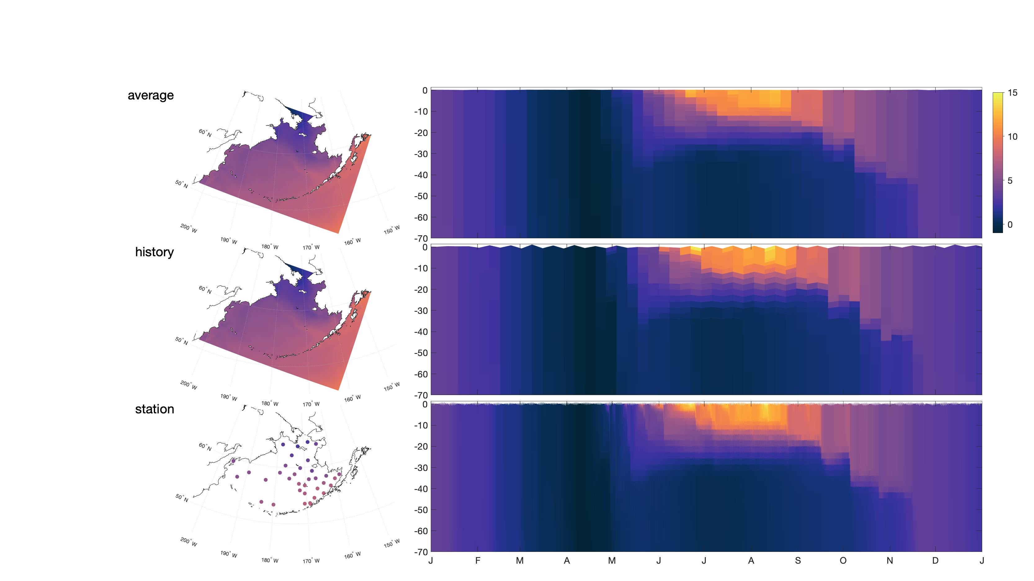
Output file types
Bering Seasons Workshop
kelly.kearney@noaa.gov
Notes:
First, sea ice. Sea ice plays a key role in modulating many biophysical properties, such as surface and bottom temperature, stratification, and light levels. When compared to satellite measurements of ice cover, Bering10K does very well replicating the interannual variability in sea ice extent and date of ice advance. However, sea ice retreat tends to be biased late by about 2 weeks. This is an improvement over an earlier version of Bering10K, where retreat was ~1 month late (see Hermann et al., 2016), but still has room for more improvement.

Slide 12
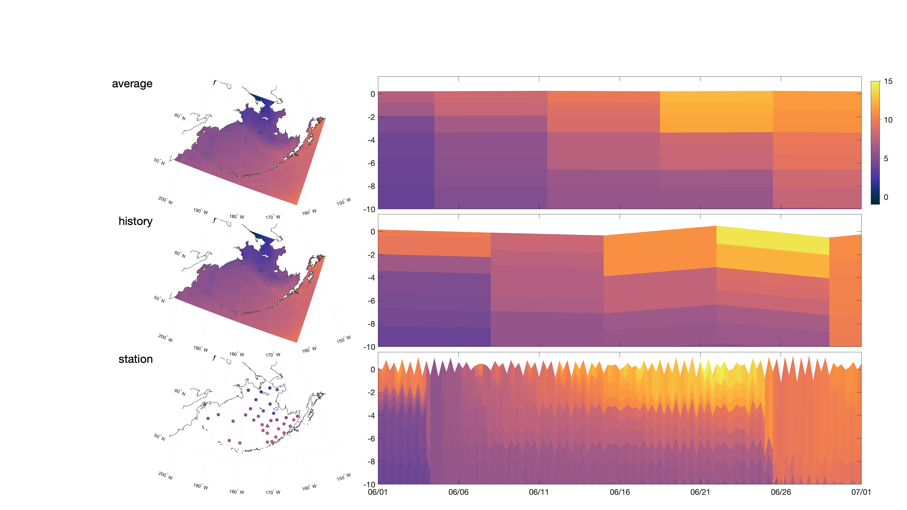
Output file types
Bering Seasons Workshop
kelly.kearney@noaa.gov
Notes:
First, sea ice. Sea ice plays a key role in modulating many biophysical properties, such as surface and bottom temperature, stratification, and light levels. When compared to satellite measurements of ice cover, Bering10K does very well replicating the interannual variability in sea ice extent and date of ice advance. However, sea ice retreat tends to be biased late by about 2 weeks. This is an improvement over an earlier version of Bering10K, where retreat was ~1 month late (see Hermann et al., 2016), but still has room for more improvement.

